Slide 2
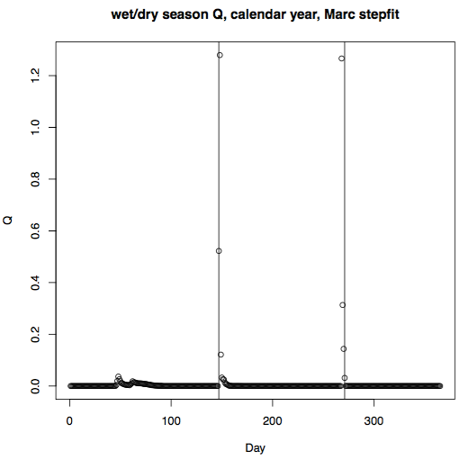
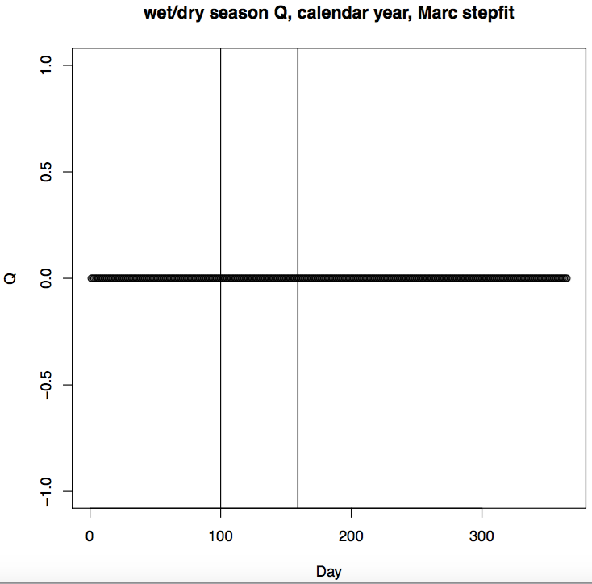
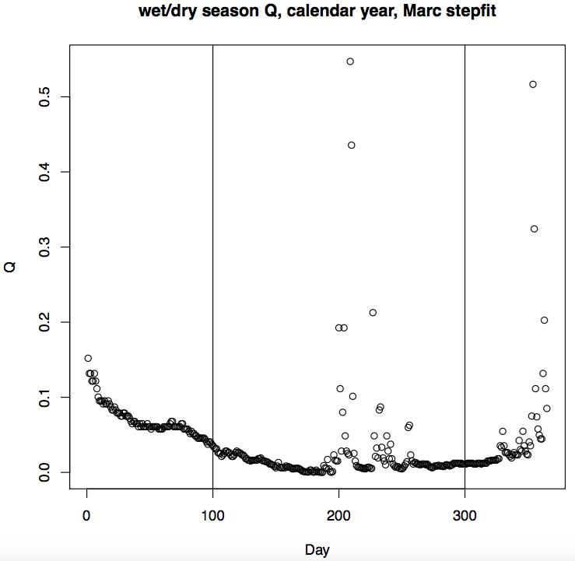
Range of possible dry start and end dates: How did Marc decide?
min nonrainy = 60 days
dry start options: 99 to (300- min nonrainy)
dry end options: (dry start + min nonrainy) to 300
Using different ranges will lead to inclusion of a lot of Decembers (the following wet season)
Some years just don’t seem appropriate for separating a dry vs. wet season. Can we ignore them?
R code: power law recession Marc’s Way.R

Slide 3
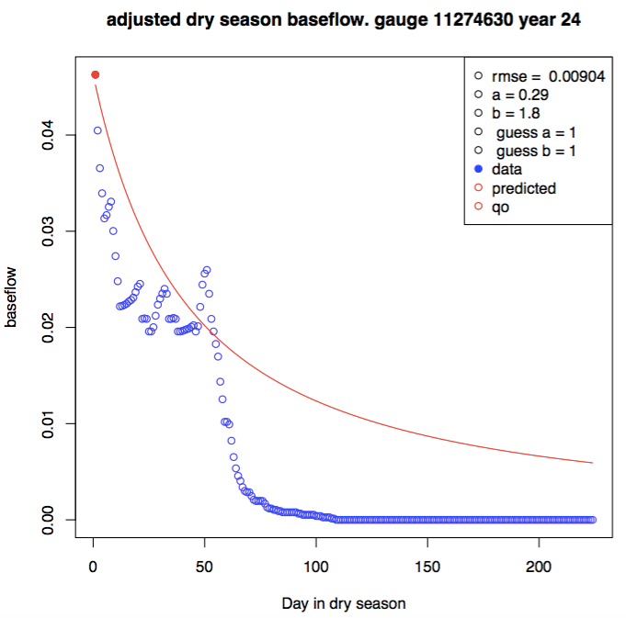
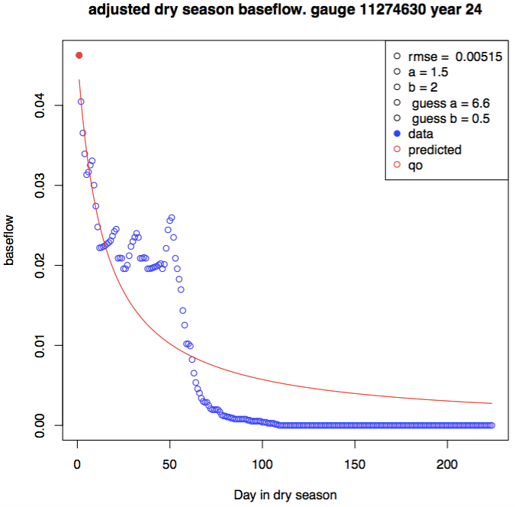
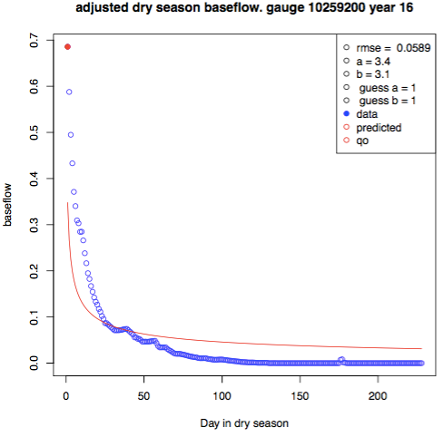
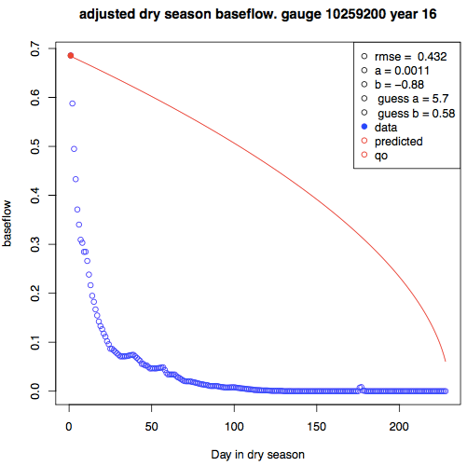
Power law fitting: this was done by SANN, but it requires an initial guess. Compare guessing a = b= 1 to guessing an a, b pair from log fitting. Using log fit doesn’t always give a better answer; sometimes it gets much worse. And when there IS an improvement, it isn’t very much.
For SANN fitting, added large penalty in the objective function whenever a <0 or b <0 so negative a and b parameters are never chosen as the optimizer.
Guesses of a and b are 1
Log fitting to guess a and b for sim annealing
A negative b happened even with the penalty.
Another run with identical code gave a much more reasonable fit.
Take average of many SANN runs and get rid of outliers? Find a better optim method?

Slide 4
(Pande and Sivapalan 2017) review of sociohydrology
Much sociohydrology work has focused on emergent properties in the time domain, but over spatially isolated domains like river basins
Sociohydrology, unlike related fields, allows human agency (socioeconomics, tech, norms, values) to be endogenous to the systems. However, the endogenization of human agency must now be extended to space and to space-time since the world is increasingly interconnected.
Related fields: hydrosociology (assessing societal impacts of a physical water system); hydroeconomics (optimize economic objectives of a water system) – both of these respond to ‘what if’ scenario-based questions, such as what would be the effect of salinity on the economic value of water, etc. the scenarios themselves remain ‘exogenous’, i.e. prescribed boundary conditions that nevertheless may change over time. Socio hydrology specifically endogenizes the generation of such scenarios by considering bidirectional feedbacks between humans and the water environment, which might generate new emergent dynamics. It follows a positivist approach of trying to understand the dynamics of coupled human-water systems, as opposed to the normative approach aimed at solving concrete water management problems. It seeks ‘recurrence’ in social behavior wrt time that is independent of space and time.
The subject matter of socio hydrology are the phenomena that emerge in different coupled human-water systems – they manifest as puzzles, paradoxes, or patterns (e.g. peaking in water resource availability as basins develop) – socio hydrology aims to interpret such phenomena in terms of dynamic two-way feedbacks and to develop generalized understanding that can connect diverse phenomena across many places and times.
Interpret emergent phenomena using cyclic process of hypothesis generation, testing and hypothesis update. In socio hydrology, begin by identifying variables (water storage, pop, crop prod, salinity) that are possibly behind a phenomenon. This is followed by formulating hypotheses on how these variables behave over time. This hypothesis is then tested.
Three branches of socio hydrology: (1) historical socio hydrology aims to understand a coupled system in the past. (2) Comparative socio hydrology aims to compare and contrast different coupled human-water systems across socioeconomic, climatic, and other gradients. (3) process socio hydrology aims to understand the nature of observed social and hydrological processes to build hypotheses about how different parts of the coupled human-water system may be dynamically interconnected (i.e. theories and models of the positive and negative
Which category does our toy model fit in? process socio hydrology – or just application of the main theories of sociohydrology instead of contributing to socio hydrology knowledge? “Talk to” sociohydrology lit using our results? How about its treatment of emergent properties over time and space?

Slide 5
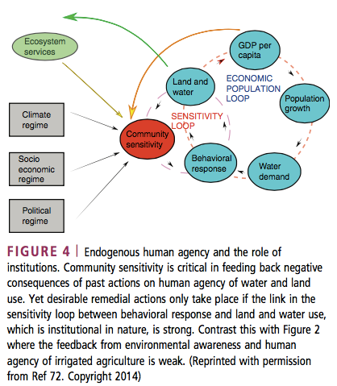
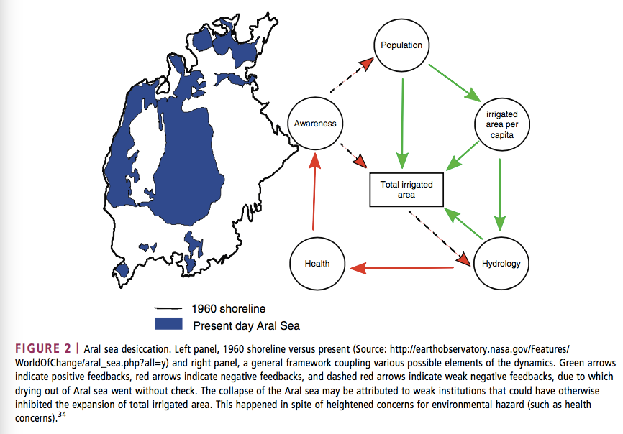
(Pande and Sivapalan 2017) review of sociohydrology
Socio hydrological knowledge generated so far has been influenced by a few selected phenomena
To endogenize human agency, there is the ‘pendulum swing’ phenomenon, or qualitative descriptions of behavior relating to population growth, levee rise, and flood occurrence. Both these approaches are in the form of a system of coupled differential equations that show an emphasis on system engineering and nonlinear dynamics. (can we use CE 295 stuff to model land use change and farmer behavior for our work?) one area that’s studied is the role of technology in ensuring a sustainable future (it doesn’t tend to, there are many unintended negative consequences). The competition between tech-mediated growth and environmental sensitivity endogenizes the human agency.
The field needs to include more diverse phenomena because knowledge can be biased by the paradoxes and the patterns people choose to study. All socio hydrological models are still low dimensional and focused on modeling temporal dynamics.
To add in spatial dimension, can endogenize the boundary conditions themselves, ie. Of trade or rainfall. This requires use to understand additional processes that connect socio hydrological entities in space, like trade, rivers, atmospheric fluxes. (this is very pertinent to our stuff, and perhaps speak to socio hydrology in the context of extending spatial emergent patterns in atmospheric connections, like ET falling as rain downwind.
Telecoupling in Land System Science, where location specific land cover dynamics is influences not just by local drivers of change such as population pressure but also distal coupled social environmental/land cover dynamics through flows such as trade and knowledge. Our project is similar – look at it in terms of telecoupling?

Slide 6
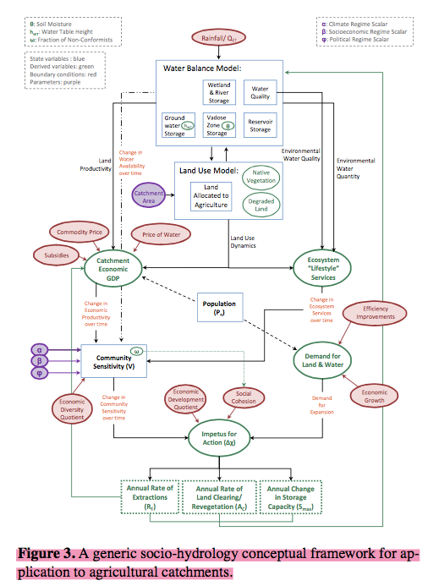
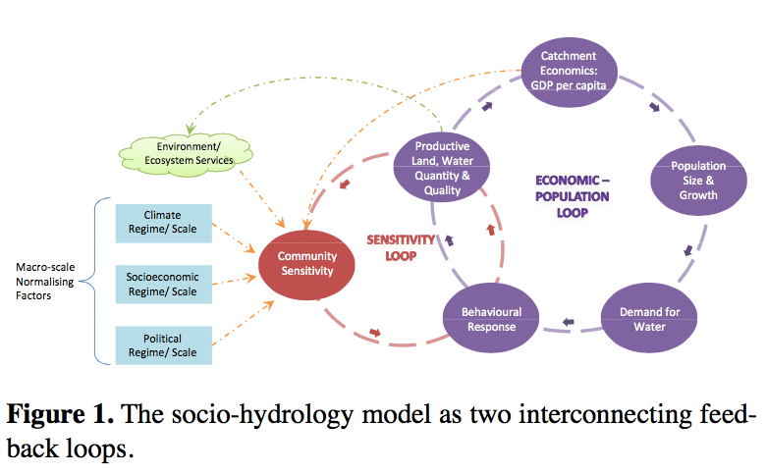
(Elshafei et al, 2014) – framework for socio hydrology models in agricultural basins
This could be the basis of the toy model in the dynamic sense – but it ignores spatial connections with different basins
The model framework has six coupled system dynamics: catchment hydrology, population, economics, environment, socioeconomic sensitivity and collective response. They introduced a socioeconomic driving variable (Community Sensitivity – or perceived level of threat to a community’s quality of life) and Behavioral Response variable – reflects land and water management decisions relevant to the hydrological context.
Used general systems theory to describe the systems – which has nonlinear tendencies with attractors to certain stable states and repelors from unstable states, and thresholds and rapid responses between state transitions. Negative feedbacks will stabilize the system; positive feedbacks will induce a shift to another position.
There are two key feedback loops: “economic-population loop” (as per capita economic gain increases, population and rate of growth increase, heightened demand feeds into water management decisions , water flows reduce causing deterioration in economic conditions, and demand for water and land reduces) and “sensitivity loop” (contains Community Sensitivity state variable which reflects community sensitivity to marginal change in water variables; as sensitivity increases, behavior will tend towards reducing community’s impact. For example, expansion phase with strong drive for anthropocentric behavior, i.e. positive feedback; followed by enviro-centric management due to negative feedbacks).
The six components of the framework: (1) catchment hydrology: must include water related management decisions relevant at catchment scale like land cover change, GW or surface water extraction, changes in the capacity for storage) that will support simulation of the coupled dynamics (2) population dynamics (3) economic function: benefit vs cost (4) ecosystem services function (5) sensitivity state variable: a function of national/regional scale factors like regional climate regime and national political/socioeconomic development; and local factors like local water availability, ecosystem services, GDP (6) Behavioral response (X) function which is driven by sensitivity and demand (which is the degree of inducement for agricultural expansion – i.e. relative importance of agri in the economy and population growth)

Slide 7
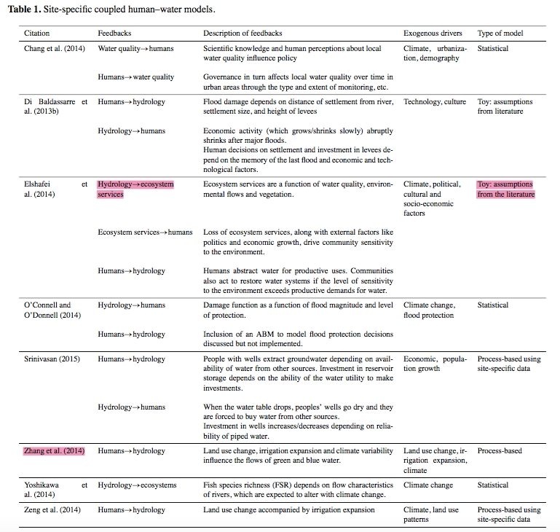
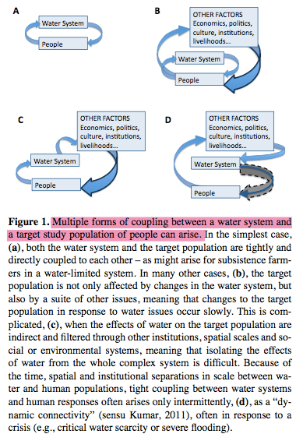
(Troy et al, 2015)
A toy model is one that makes assumptions from the literature. Look at the table they have for examples of toy models.
In socio hydrology, humans and their activities are part of the water cycle, instead of an external driver. Improved understanding of the relationships between human decision making and the water system itself may lead to better prediction, and thus management, of water systems.
Different water-society dynamics that are studied: because observational periods are often constrained, many studies are only able to explore the one-way influence of water -> humans or humans -> water. It’s also possible that in some cases one-way feedbacks are all that exist.
one-directional influence: studies that focus on the “natural systems paradigm” in which human action is externalized and treated as a perturbation to the natural hydrologic regime (Ximing Cai’s GW irrigation in High Plains is an example). The one-directional nature of influence in these studies probably is due to timescale separation between rapid timescales of human intervention in the water cycle and longer timescales on which these interventions alter ag productivity, or due to spatial scale separation (i.e. between international trade and local farmer decision-making)
Two-directional coupling: these couplings don’t necessarily change over time
Dynamic connectivity: two way coupling that changes with time. Perhaps the system will switch between one way and two way feedbacks, depending on the rate at which sensitivity develops. The system might switch between one way and two way feedbacks depending on the balance between supply and demand. The rate at which sensitivity develops is strongly socially mediated.
It is problematic to confine sociohydrologic studies to only strong two way human-water feedbacks; this tight coupling is actually a special case, arising in systems with simple water and social infrastructure, such as irrigated subsistence ag in a water limited region, or in situations with a water crisis. Social responses to hydrologic crises may be significantly delayed

Slide 8
(Troy et al, 2015)
Research methods have used a range of methods, including historical analysis, simplified systems of differential equations, and statistical-empirical analyses. A particular example comes from complex system studies, and it’s a method to evaluate causal relationships (e.g. information theory, synchronicity and time delays, and entropy-based measures); to reconstruct the underlying complex system based on time series measures (e.g. attractor reconstruction, recurrence metrics, etc.), and to analyze time series based on object oriented occurrences of patterns in the time series. Alternatively, try to do “randomized controlled trials” – which needs a strategy to identify random selections in real world empirical data.
The final method area in socio hydrology is modeling. Modeling approaches range from “toy” models consisting of a few coupled differential equations, to detailed region-specific models. Many of these models don’t depart from the current hydrological paradigm, but Elshafei does. Features like dynamic connectivity, threshold behavior, and multiple stable states are characteristic of nonlinear systems. To date, modeling studies tend towards being very specific, and thus hard to generalize beyond the case study, or very general and thus dependent on the construction of “environmental sensitivity” metrics, which are hard to measure or describe in concrete terms. In the future, the use of data analytics to unravel networks of cause and effect, in conjunction with numerical modeling to explore the potential behaviors that such networks can produce, could provide a robust and generalizable approach to understanding these systems.
Two major takeaways: first, that two way feedbacks between human and water systems don’t always exist and therefore it’s inappropriate to begin by assuming they do; and second, socio hydrology can draw on complex systems science and data analysis
Two ways to model human agency: top down approach to model society itself at time steps of years to decades, or start at level of human beings with institutions developing through personal relationships of individuals.

Slide 9
(Srinivasan et al, 2017)
There are three critiques on socio hydrology models: there’s absence of feedbacks between water and society; the models are created by scientists who don’t know what stakeholders actually care about; and models fail to connect global forces to local water resources.
These critiques arise because the models used for long term planning tend to be extensions of medium term planning models, which implement long term climate scenarios using simplistic assumptions of population, land use and cropping patterns. Lifestyle choices and societal goals are usually fixed in conventional predictive models, which is a problem because humans have agency: the capacity to think and act independently in response to new information. Models ignore the cultural and institutional context for water management decisions. However, even if we predict emergent phenomena due to human agency, we can’t predict extreme social disruptions such as wars, natural disasters, new technologies or social movements. These “black swan” events mean that models should be stress tested to assess system robustness.
Second, models tend to highlight aggregate benefits such as total food and energy production, but not distributions of benefits and costs. Inequality and power differentials are a kind of feedback that would be missed if water users were treated as a single homogeneous group.
Third, place-based studied are problematic because the basin no longer captures geographical “boundedness”.
Water managers want to know a portfolio of options, how actors will respond to them, and welfare consequences for which people and over what time frame (i.e. want a possibility space) instead of a quantitative, probabilistic distribution of water demand and supply for a particular time slice.
Comparative case studies and building generic sociohydrological models that aim to replicate emergent phenomena observed in multiple locations is a good start. Goal should not be to create a “model of everything”; the model scope must still depend on the types of policies and future conditions the model aims to evaluate.
Need new data sources: big data, citizen science, participatory monitoring, new sensing technologies or satellite data.

Slide 10
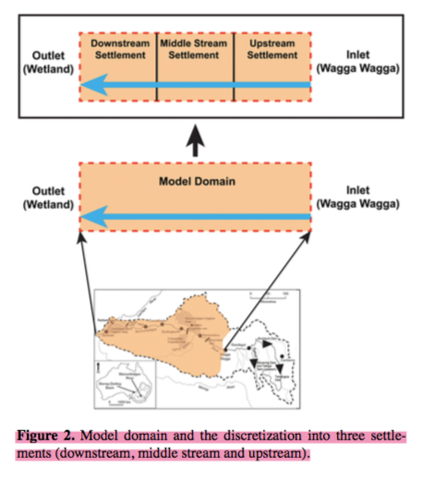
(Emmerik et al, 2014) – dynamic model of Murrimbidgee River (MRB)
Data shows a pendulum swing between agricultural development and restoration of ecosystem services. This model has coupled nonlinear ODEs to describe interaction between five state variables: reservoir storage, irrigated area, human population, ecosystem health, and environmental awareness. These equation are:
Hydrology equation (water balance) including irrigation water use. The model is conditioned such that if there is a persistent deficit in the water available to meet irrigation demand, a reservoir is introduced endogenously to mitigate deficit.
Irrigation equation (irrigation area per capita as function of water availability, tech change and environmental degradation
population equation (includes relocation inside basin). The model assumes people move in or out of a region based on its relative attractiveness level, equal to per capita irrigation potential.
Ecology equation (simulates wetland health only) wetlands are recharged when flow exceeds a prescribed threshold release from the downstream settlement.
Environmental awareness equation (tracks awareness of wetland health only) – environmental awareness happens when wetland quality degrades below a threshold. If wetlands are fine over long period of time, awareness decreases over time (i.e. awareness is a memory bank that accumulates when environment degrades and depletes during healthier times).
Explicit interconnections are built in between these five equations through assumed constitutive relationships to allow feedback. These equations are NOT prescribed; rather they are obtained by calibration using expert knowledge and desire to keep it simple and realistic.
Wealth, technology, yield, and crop water demand connect irrigated area per capita to hydrology equations. Technology increases as gross basin product (GBP) increases. Technology is an endogenous var and in turn it leads to higher yield, reduced crop water demand, increased irrigated land per capita.
Why are the red and green arrows labeled the way they are? Red means something that goes towards more environmentally conscious behavior? Read about feedback loops…

Slide 11
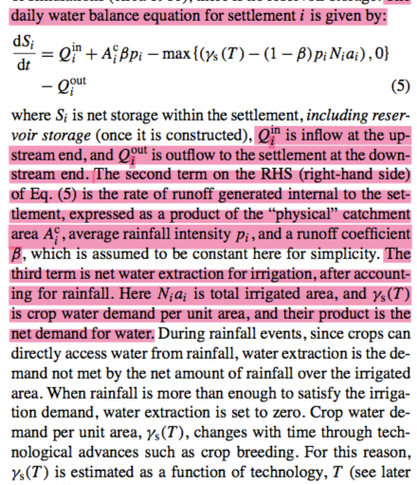
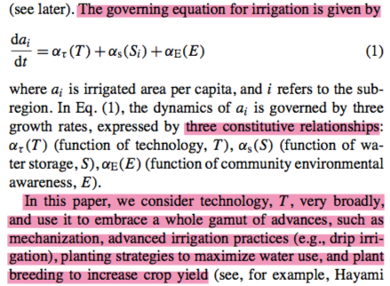
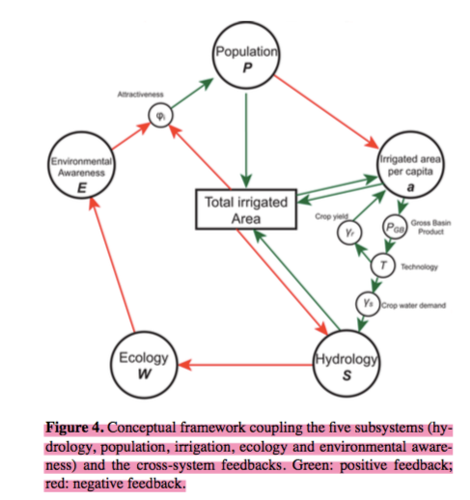
(Emmerik et al, 2014)
The external drivers are rainfall time series, upstream flow, and global food price of rice in particular, which acts as a surrogate.
There are a lot of parameters to be calibrated, and they did sensitivity analysis to determine how prone it is to equifinality.

Slide 12
(Avery’s paper)
First, looked at influence of forest loss in concentric rings on temperature of patches of intact forest in a center pixel. Then, they used the results to estimate the influence of the loss of each forest patch in the pixel on the temperature of agriculture in concentric rings around the forest patch. How are these two concepts connected?
First, modeled temperature around weather stations in natural forest pixels as regression of many different factors like radiation, elevation, long and lat, distance from water bodies and coast, and slope.
Then, used coefficients obtained from first step to predict temperature in natural forest. The analysis identified the effects of 1 km2 of forest loss at different distances using a regression model. These relationships can be inverted to estimate the amount of cooling a patch of forest provides agriculture in different distance rings.

Slide 14
TO DO
Draft abstract for CUAHSI on Botter suitability and submit
Things to check
Make table of parameters and relevant files for running Marc’s stuff
For power recession TO DO
Read Dave’s a, b careful paper for more information.
Look at Marc’s code – see if can run them because they would make a good double check/validation of my code
Might need to ignore the “chunks” of constant Q which are probably sensor error.
NSE TO DO
For NSE calcs between data CDF and analytic CDF: take out the first (smallest flow) bin to compare to the dataset that doesn’t have zero flows – to make comparison fair
Note how Marc found NSE – check his code
NOTE how Marc found NSE in his paper: the evaluation metric he uses is NSC for FDC applied to the flow quantiles (350 in all? Or what? – look at Eqn 24). Took log of the flow quantiles before finding NSC to remove effect of very large floods. Used error-duration curves (Pugliese et al, 2013) to assess the repartition of errors across flow quantiles

Slide 15
AgroServe TO DO
Learn Python, Google Earth Engine
https://developers.google.com/earth-engine/tutorials
https://developers.google.com/earth-engine/edu
https://developers.google.com/earth-engine/
Learn about Jupyter and Ipython and Earth Engine Python API
Learn crop model from Jake
Ready sociohydrology papers with focus on studies by Van Emmerick, di Baldassarre, Elshafei as a starting point for toy models. Also think about the points they make about spatial sociohydrology – nice angle to think about for the “Rolls Royce” outcome
read Avery’s forest to T to agri prod paper (check Slack) – sensitivity analysis of his work; also adapt his code into R
Overall goal: figure out the land use vs. yield curve by applying crop model to lots of land use caes
in Earth Engine, find mapbiomas dataset. Over the space of Brazil, choose different pixels (around size 1km; aggregate if mapbiomas pixels are smaller). For each pixel, add 2km and 4km rings (called neighborhood 1 and neighborhood 2). For each pixel and ring shaped neighborhood, look at four cases: 0 to 25% soy; 36-50% soy; 51-75% soy; 76-100% soy. Classify each pixel and its neighborhoods in one of these 64 cases.
run the crop model in Google Earth Engine to get an estimate of productivity for all the 64 cases. For me, it will be either natural vegetation or soy. The result of this crop model run is to produce a LC vs. yield graph which will help with the toy model.

Slide 16
Marc’s seasonally dry parameters
Parameter | calculation | file | notes
a, b power law recession | Calibration by simulated annealing | Power law recession Marc’s Way.R | Involves Td calc, baseflow sep. guessed a and b values using log fit before simulated annealing.
Td (for power law recession) | Calculated per individual calendar year | Power law recession Marc’s Way.R and FCN_findDrySeason_stepfit.R | Here, Td is not only step fit of individual year, but is also adjusted to account for the fact that last peak of wet season doesn’t exactly fall on this step fit result. Td here is for Q, not rain. Assumed wet season starts on Jan 1 – i.e. didn’t go beyond calendar year. Should be ok because last peak of wet season unlikely before Jan 1.
Last wet season peak |  | FCN_findLastSeasonPeak.R | This was calculated from start of wet season, not calendar year
Td (overall) | Step fitting of all years’ data | Calculate Dry Season.R | Rainfall and Q season separation using all years simultaneously. Made sure the Td used in Testing Marc Seasonally Dry v2.R corresponds to flow wet/dry delineation, not rainfall wet/dry delineation.

Slide 17
General climate classification
relook at climate classification.R and incorporate Xue’s indeces in classification; compare climate classification.R’s classifications into snow/no snow and seasonally dry/not seasonally dry with what Xue’s indeces would do
Code up Schaefli’s snow dominated catchments (requires hypsographic curve and z* calibration…)
Lit review of how pdfs are treated in seasonal climates beyond Marc’s work. Can any other method be applied to ours?

Slide 18
(Schaefli et al., 2013)
Snow-dominated pdfs for “zone I and II catchments” – i.e. they are affected by multiday snow storage, but the snow melts within a season (no glaciers)
Need two new parameters to build on original Botter:
A*: this is found using A*= A * P(Z > z*). The P(Z > z*) means portion of basin that is above a threshold altitude z*, and this P value can be found using the hypsographic curve (which shows the portion of land that exists at various elevations in a basin). To determine z*, the method uses calibration. Once all other parameters are found, adjust z* to fit the observed pdf. NEED TO RETURN TO THIS because need to find hypsographic curve using ArcGIS? Also, what is the use of having to calibrate z* in ungauged basins? Can there be another way to find z*, like relations between elevation and temperature?
kD: this is from tau_D, which is the mean duration of periods with temperatures less than 0 Celsius
The regular (summer) recession will be k, and they calculated it using Brutsaert-Nieber 1977, using Q below 90% of the summer flow quantile.
Did they find precip statistics from the responsive area only or for the whole area?

